Slide 1

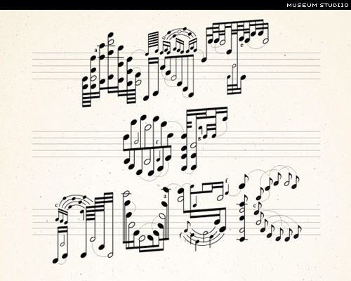
Association mining of music and text
Musical Features
Available Data
Frequency of words in each song

Slide 2

STEPWISE Methodology
Step # | Objective | Algorithms Used
1 | Establish relationship between words and musical features | LDA + Clustering
Recommendation System
2 | Use musical features to find most probable words | Kmeans
3 | Use musical features to find most probable words | Kmeans + LDA
4 | Use musical features to find most probable words | -----
5 | Use Ensemble of all 3 and calculate ranks using weights | w₁*(#2)+w₂*(#3)+w₃*(#4)

